Slide 1
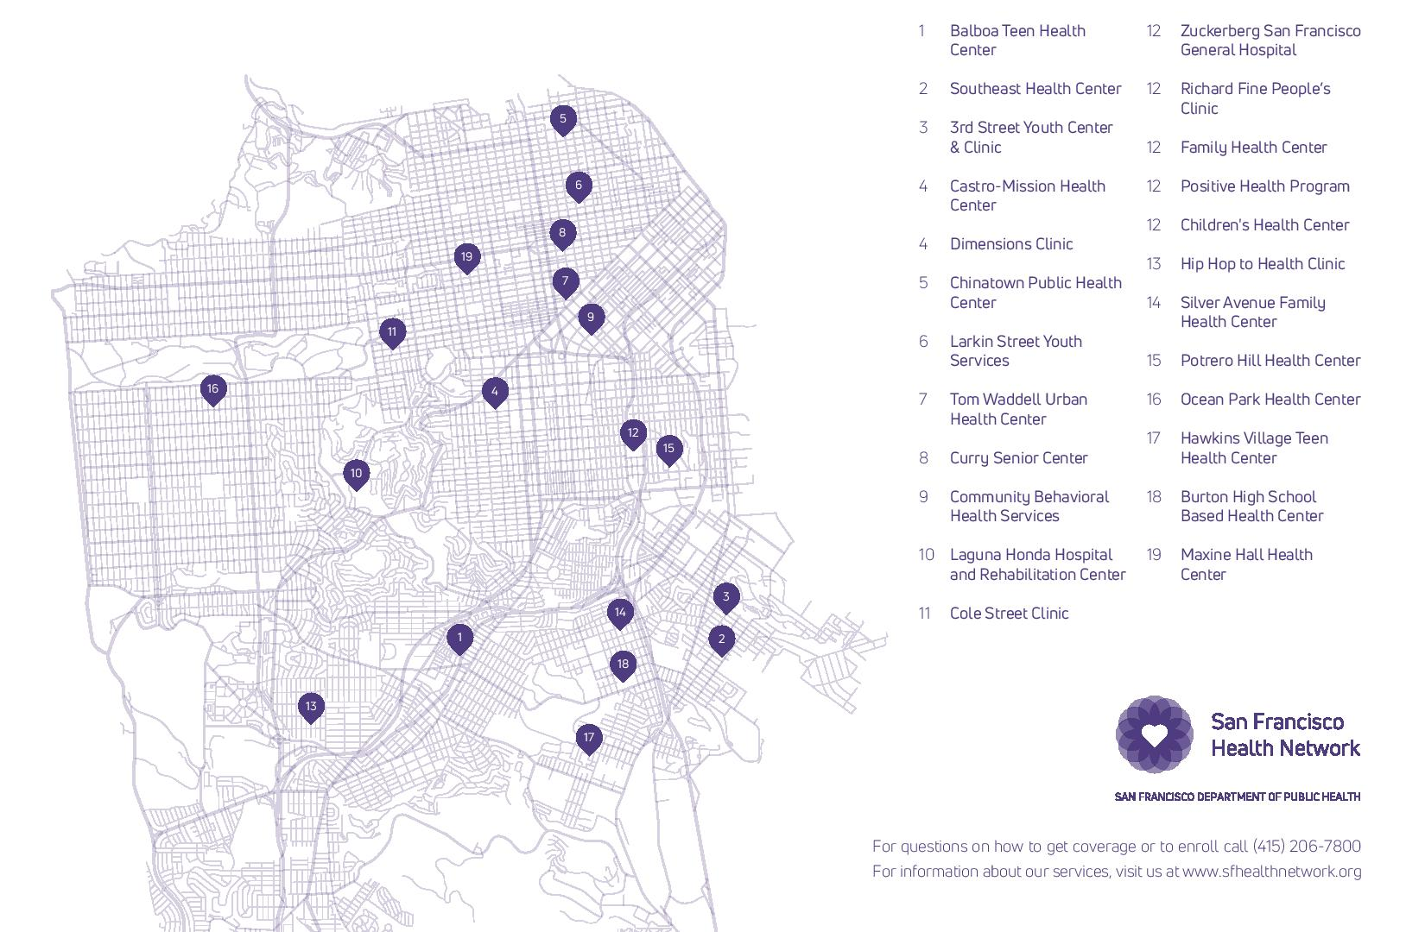
Health Center Map
Notes:
Add purple map from robin

